Slide 1
Online Voter Registration
Quick Easy Powerful

Slide 2
WHY Register?

Slide 3
WHY Register?
TO VOTE

Slide 4
WHY VOTE?

Slide 5
WHY VOTE?
-Your Own Self Interest -It is your right -People have fought and died to protect your vote -Political? Support your vision of your community and country -It doesn’t have to be political; vote issues, vote what you believe -“Failure to vote is not an act of rebellion. It’s an act of surrender.” -Your Own Self Interest -It is your right -People have fought and died to protect your vote -Political? Support your vision of your community and country -It doesn’t have to be political; vote issues, vote what you believe -“Failure to vote is not an act of rebellion. It’s an act of surrender.” -Your Own Self Interest -It is your right -People have fought and died to protect your vote -Political? Support your vision of your community and country -It doesn’t have to be political; vote issues, vote what you believe -“Failure to vote is not an act of rebellion. It’s an act of surrender.” -Your Own Self Interest -It is your right -People have fought and died to protect your vote -Political? Support your vision of your community and country -It doesn’t have to be political; vote issues, vote what you believe -“Failure to vote is not an act of rebellion. It’s an act of surrender.” -Your Own Self Interest -It is your right -People have fought and died to protect your vote -Political? Support your vision of your community and country -It doesn’t have to be political; vote issues, vote what you believe -“Failure to vote is not an act of rebellion. It’s an act of surrender.” -Your Own Self Interest -It is your right -People have fought and died to protect your vote -Political? Support your vision of your community and country -It doesn’t have to be political; vote issues, vote what you believe -“Failure to vote is not an act of rebellion. It’s an act of surrender.” -Your Own Self Interest -It is your right -People have fought and died to protect your vote -Political? Support your vision of your community and country -It doesn’t have to be political; vote issues, vote what you believe -“Failure to vote is not an act of rebellion. It’s an act of surrender.” -Your Own Self Interest -It is your right -People have fought and died to protect your vote -Political? Support your vision of your community and country -It doesn’t have to be political; vote issues, vote what you believe -“Failure to vote is not an act of rebellion. It’s an act of surrender.”

Slide 6
WHY VOTE?
-Your Own Self Interest

Slide 7
WHY VOTE?
-Your Own Self Interest
-It is your right

Slide 8
WHY VOTE?
-Your Own Self Interest
-It is your right
-People have fought and died to protect your vote

Slide 9
WHY VOTE?
-Your Own Self Interest
-It is your right
-People have fought and died to protect your vote
Political?
Support your vision of your community and country

Slide 10
WHY VOTE?
-Your Own Self Interest
-It is your right
-People have fought and died to protect your vote
-Political? Support your vision of your community and country
-It doesn’t have to be political; vote issues, vote what you believe

Slide 11
WHY VOTE?
-Your Own Self Interest
-It is your right
-People have fought and died to protect your vote
-Political? Support your vision of your community and country
-It doesn’t have to be political; vote issues, vote what you believe
“Failure to vote is not an act of rebellion. It’s an act of surrender.”

Slide 12
Online Voter Registration
Quick. Easy. Powerful.

Slide 13
Online Voter Registration
Quick. Easy. Powerful.
It all starts at
MNVOTES.ORG

Slide 14
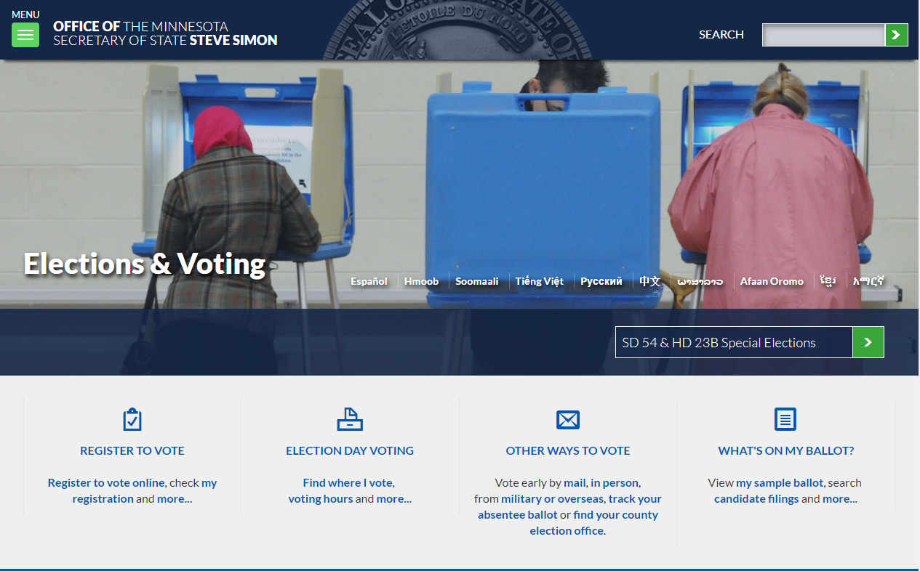

Slide 15
FIVE STEPS
1) Qualify
2) You
3) Your address
4) Verify your address
5) Signature and oath

Slide 16
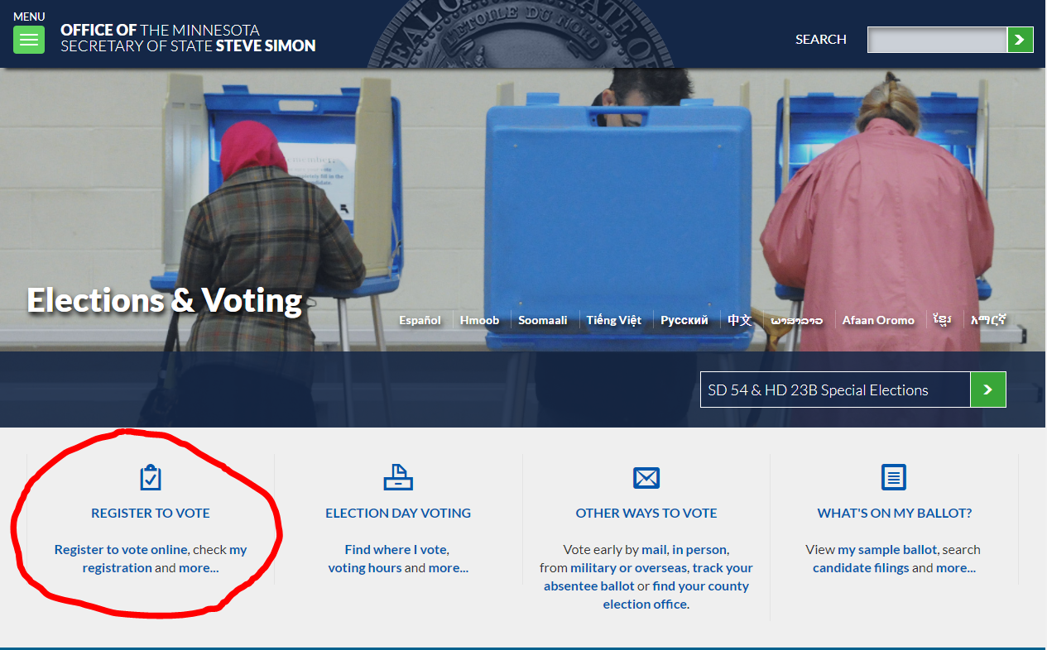

Slide 17
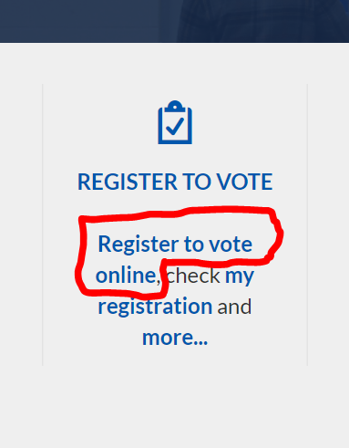

Slide 18
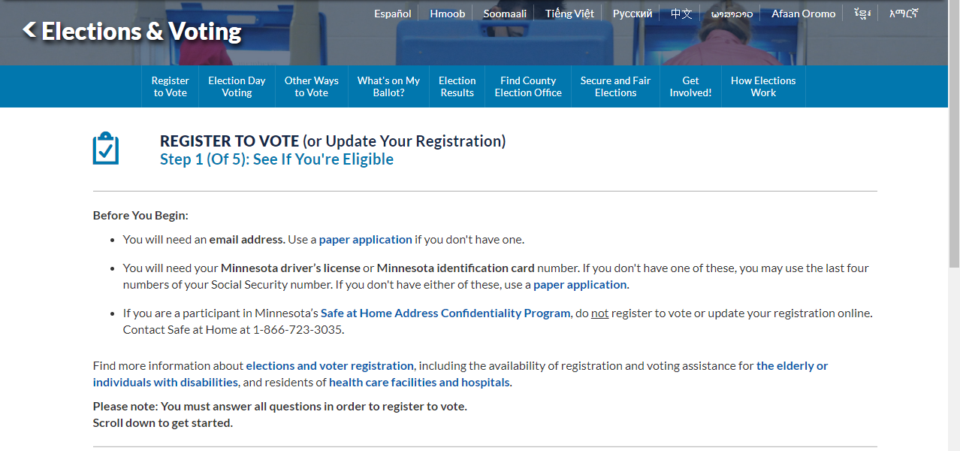

Slide 19
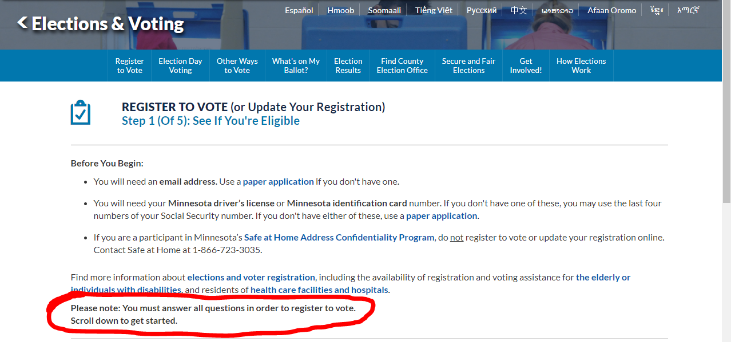

Slide 20
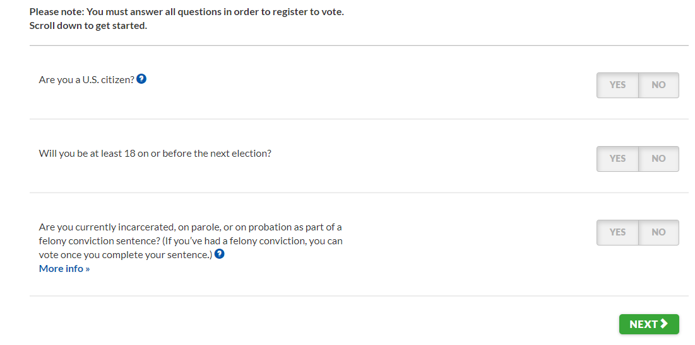

Slide 21
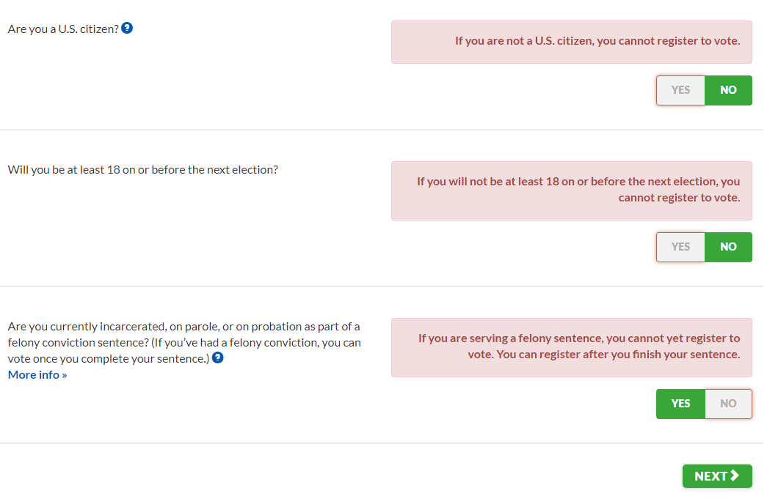

Slide 22
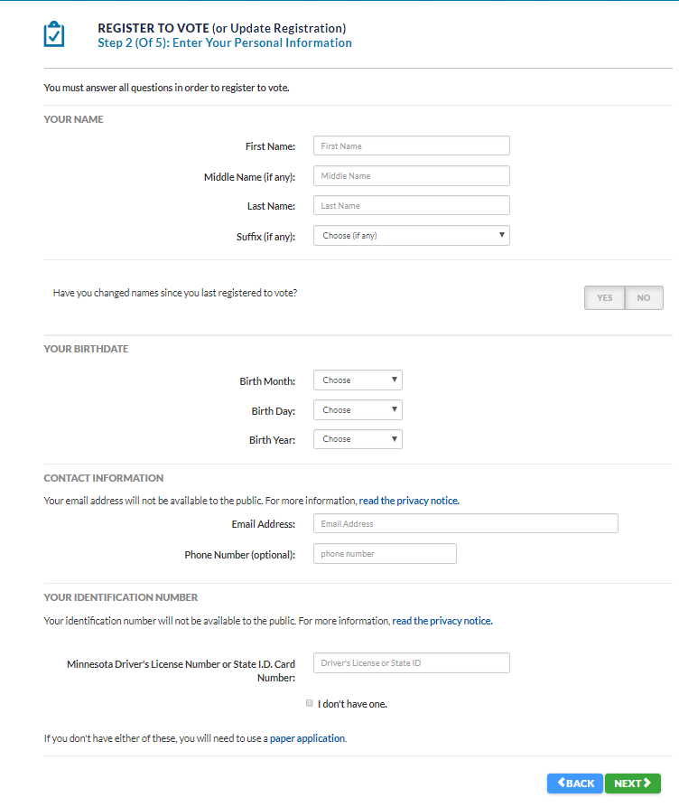

Slide 23
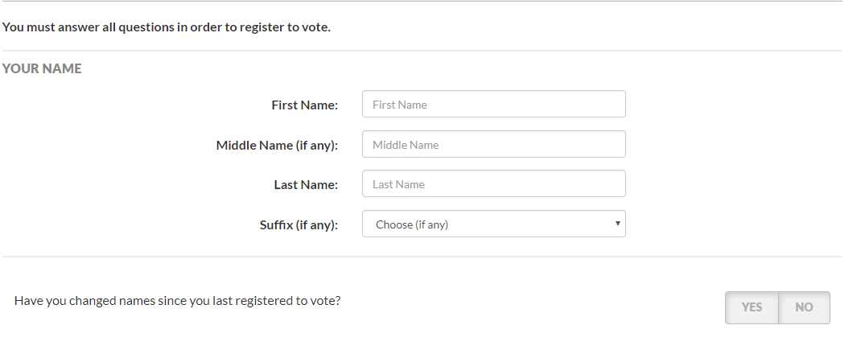

Slide 24
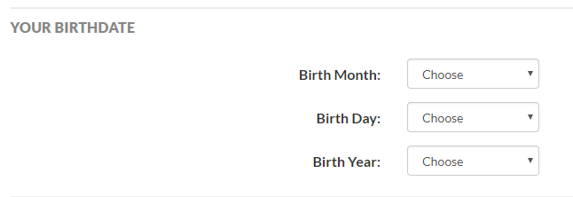

Slide 25
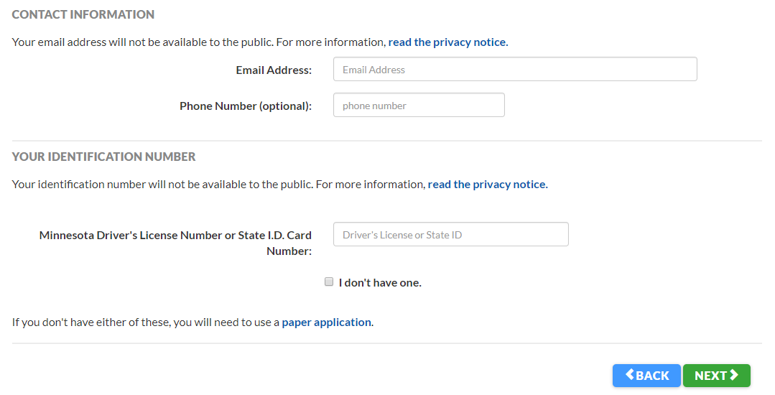

Slide 26
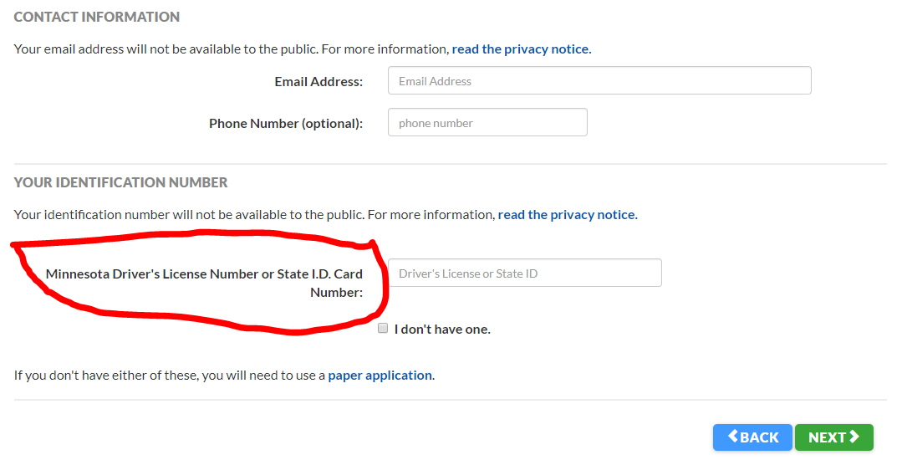

Slide 27
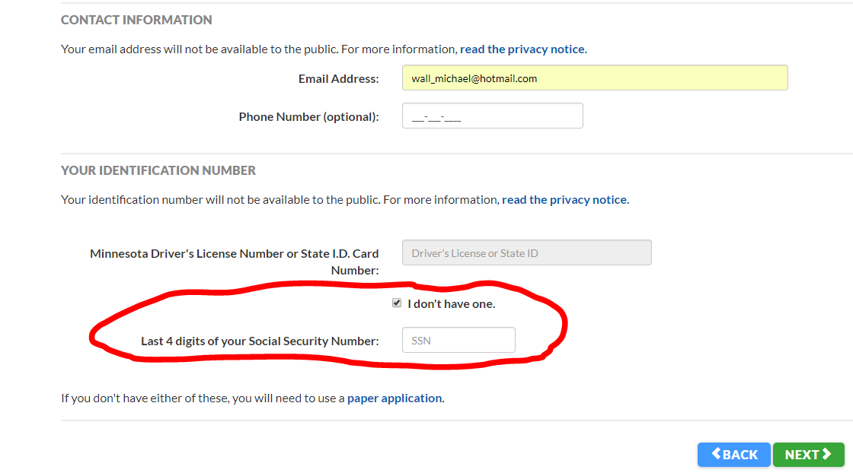

Slide 28
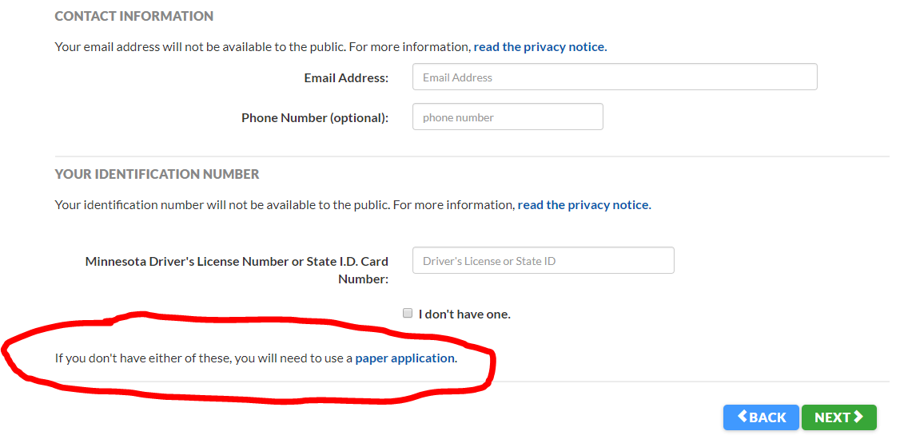

Slide 30
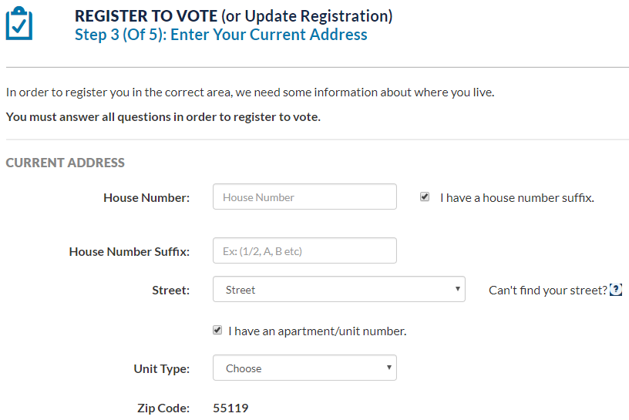
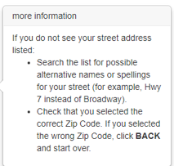

Slide 31
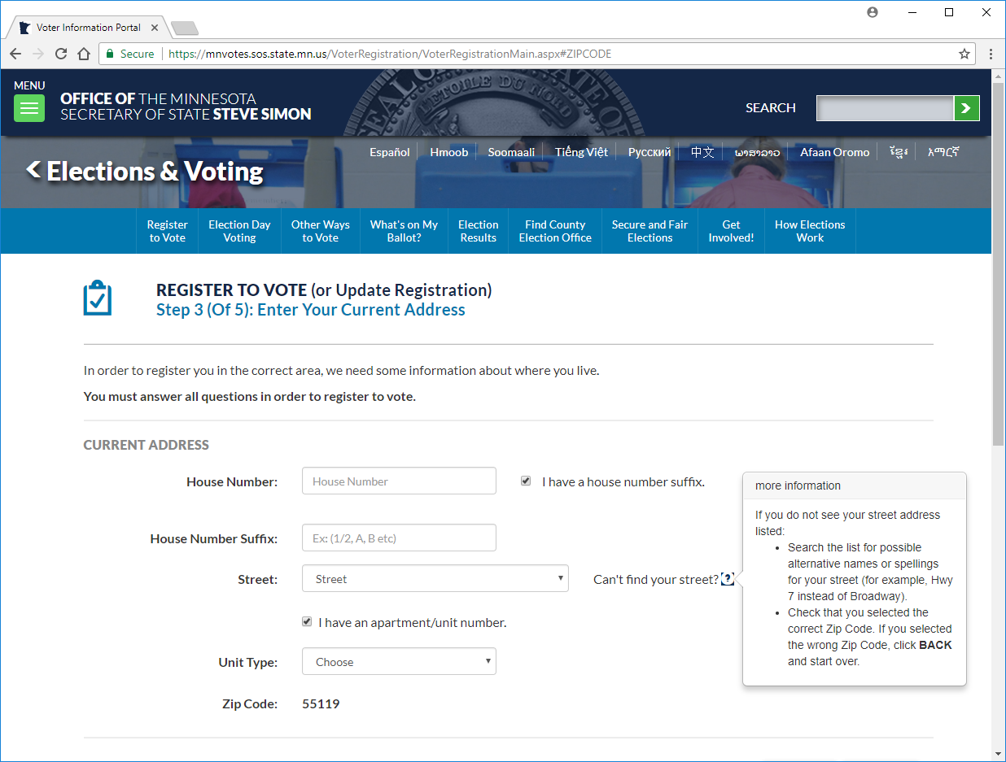

Slide 32
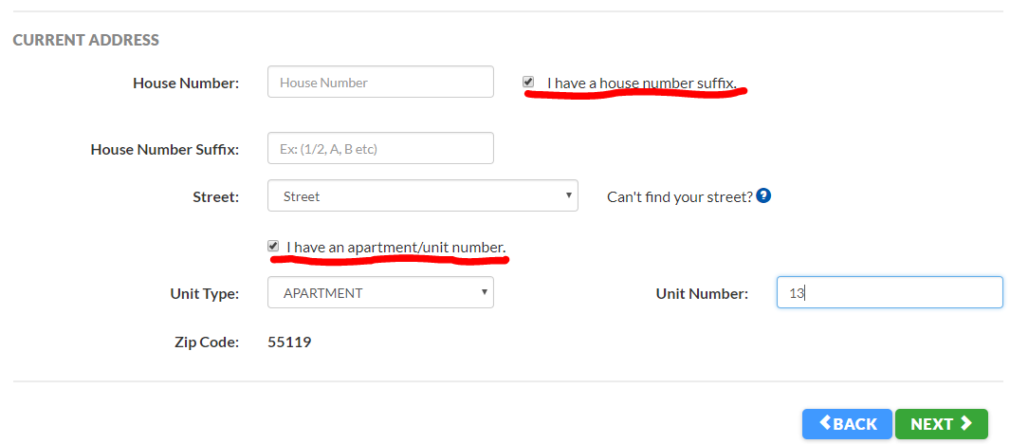

Slide 33
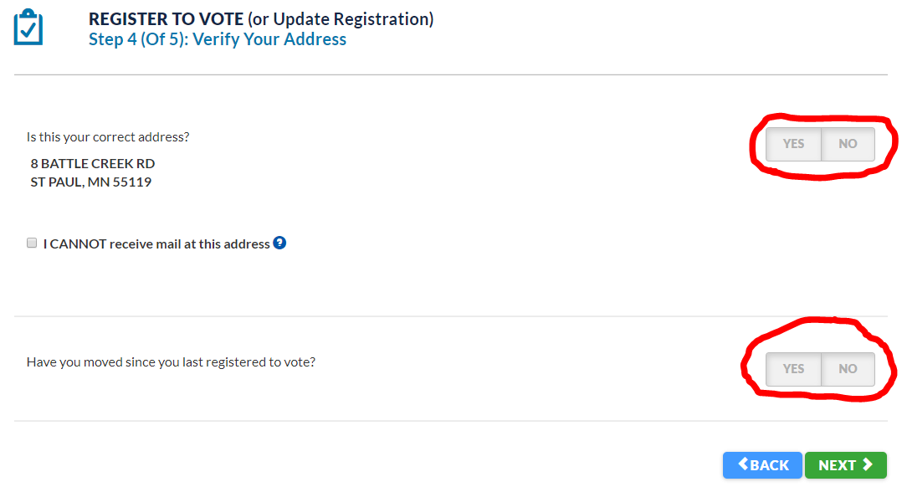

Slide 34
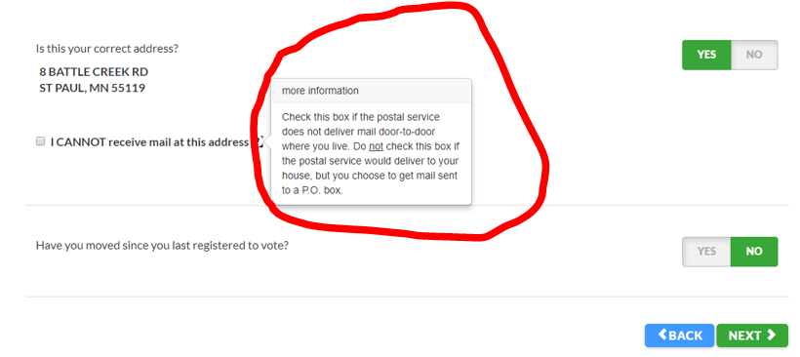

Slide 35
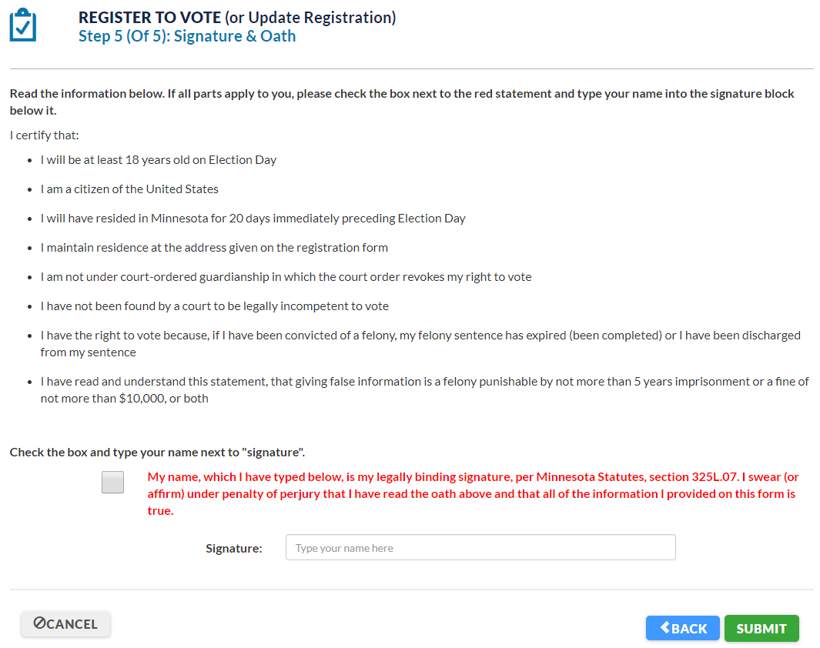

Slide 37
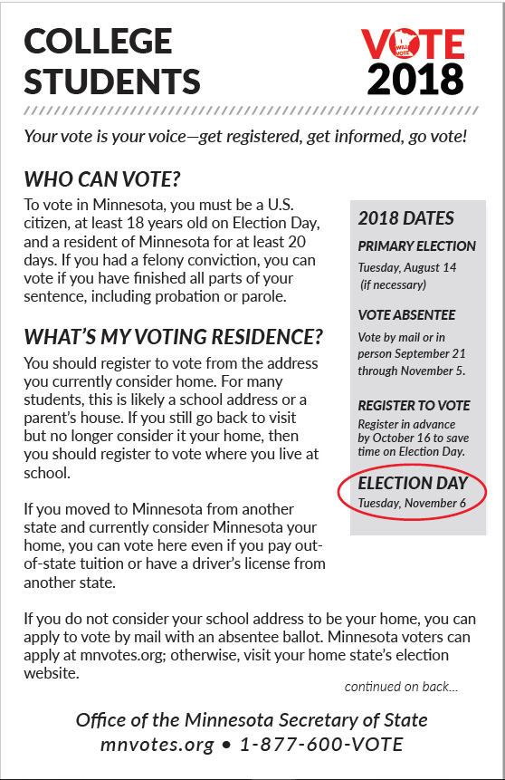
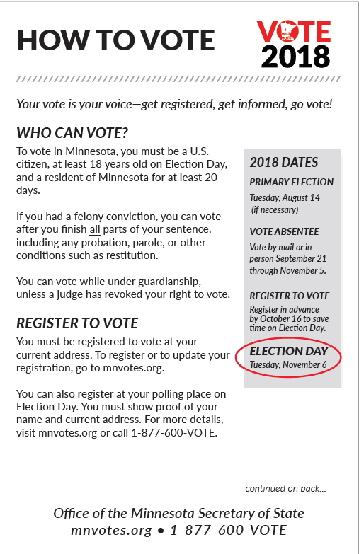
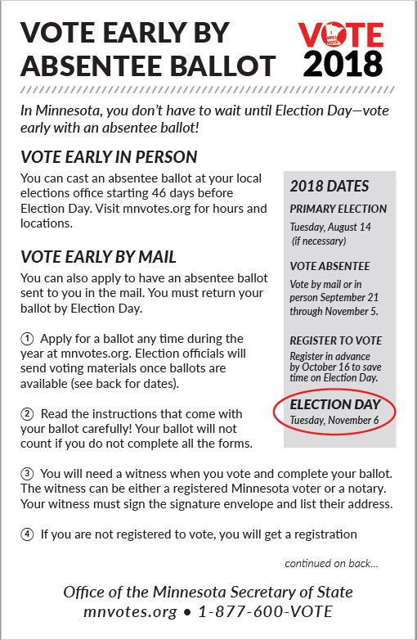
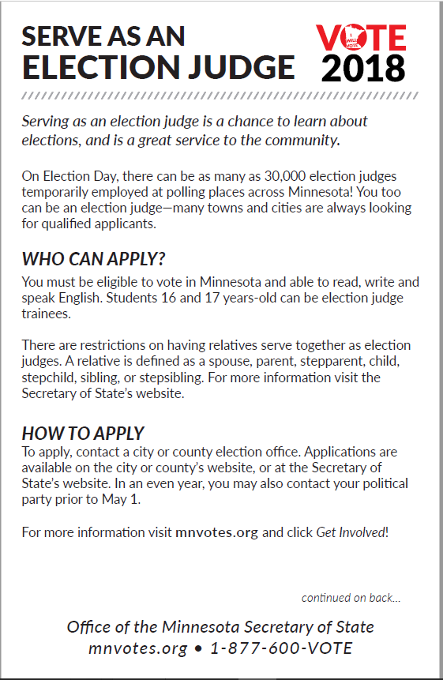

Slide 38
